Slide 1
Time Series
Features and Statistical tests
Oscar Torreno - @oscartorreno
David Cuesta - @Dcuesta7
Notes:
Buenas tardes,
Me hace especialemente ilusión daros la bienvenida a esta charla, porque en este mismo edificio me he pegado unos 10 años estudiando.
Primero estudié ingeniería informática, luego estuve un tiempo trabajando y más tarde me engañaron para que hiciese el doctorado sobre
computación paralela con GPUs. Y Bueno pensé que si la PyCon viene a mi casa aqui no puedo faltar yo.
Estaréis pensando que viene a contarnos el Loco este no?, pues bien ni más ni menos que de time series y de como podemos usar
las GPUs para acelerar la ejecución de algoritmos que operan con ellas

Slide 2

Features extraction
Features are typically statistical values or associated concepts that summarize a given time series.
Typically used to: accelerate computations, have a set of common features for series of different lengths, etc.
Examples: mean, maximum, minimum, median, kurtosis, number of points above the mean, symmetry looking, etc.
Existing libraries: Khiva, tsfresh, etc.

Slide 3
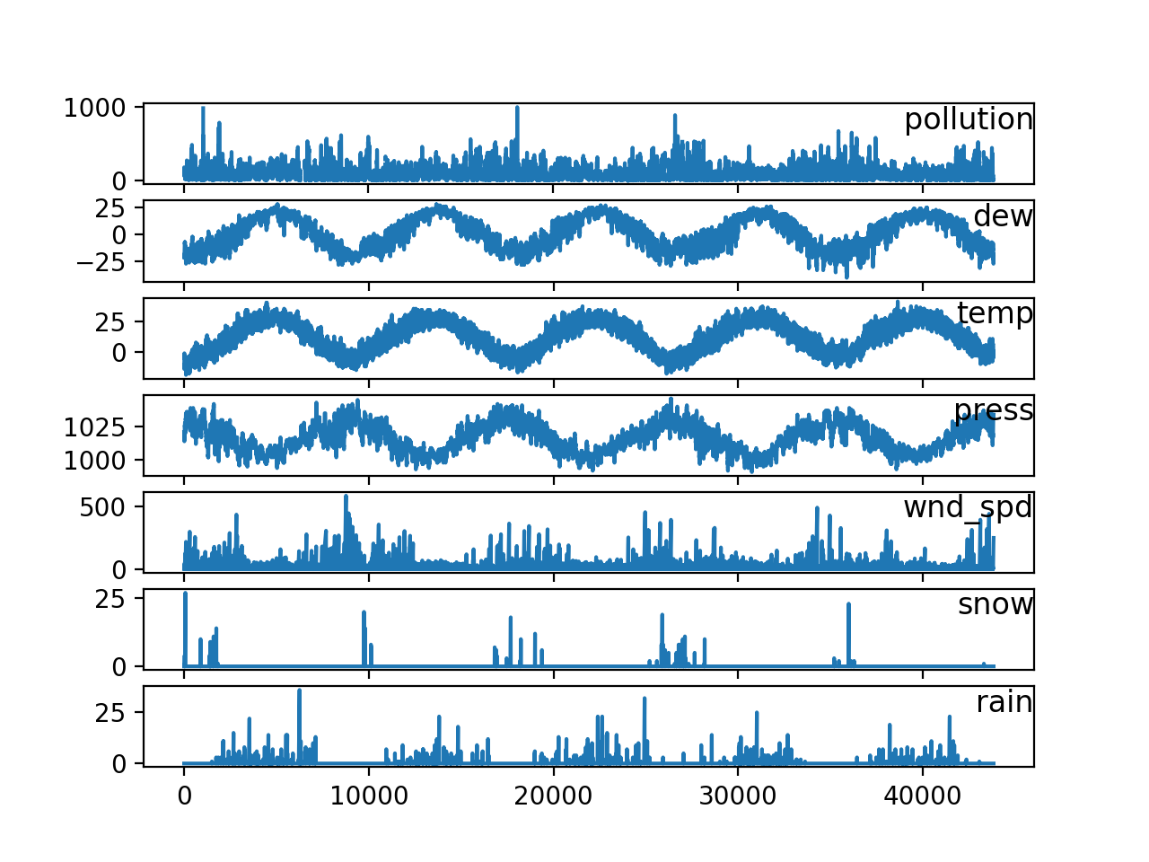
What can we use features for?
To apply classical machine learning algorithms mainly for clustering and prediction/forecasting
A B C
A D C
. . .
. . .

Slide 4
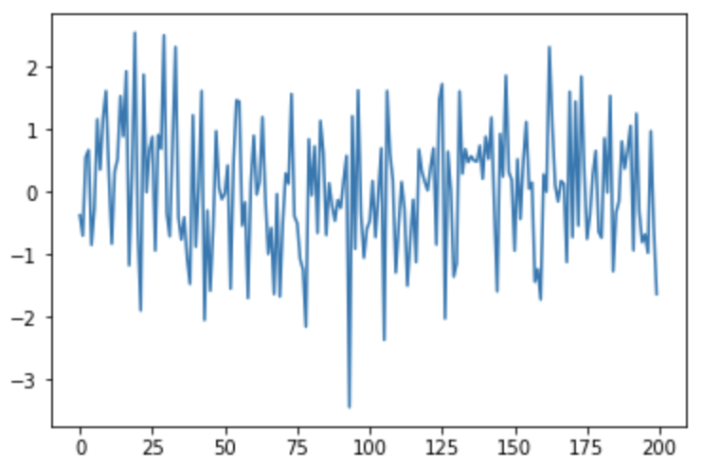
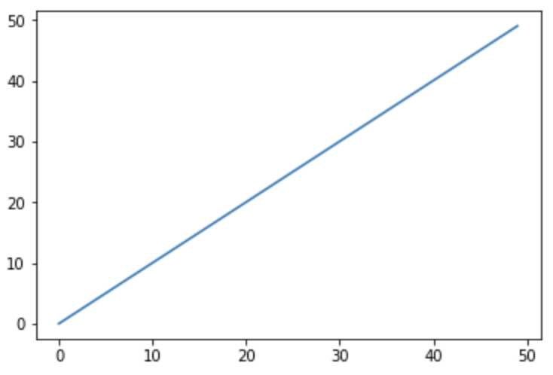
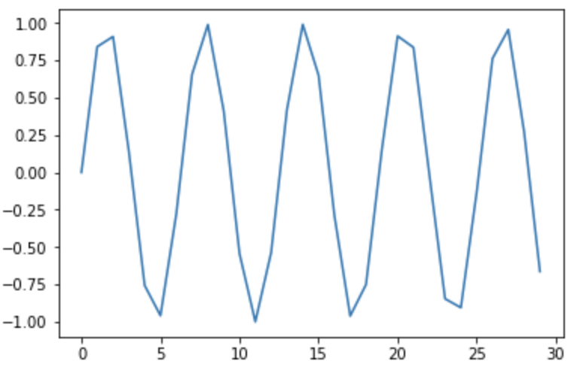
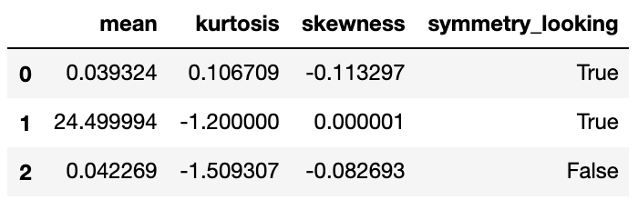
Features. Example

Slide 5
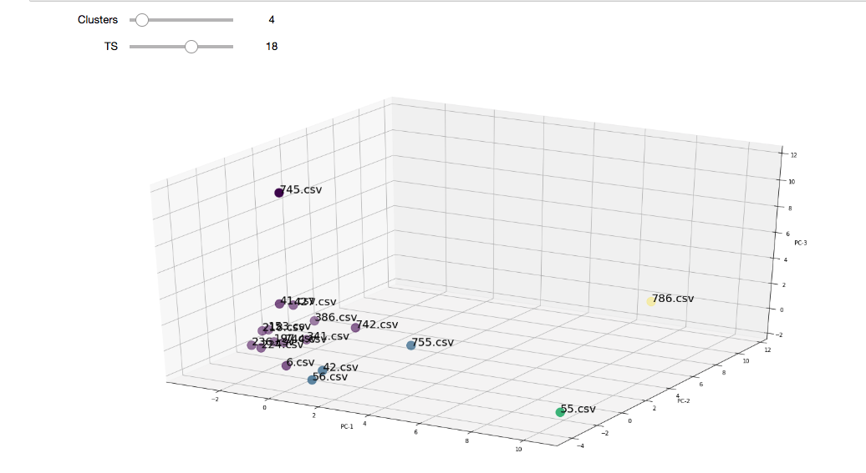
Features extraction. Use cases
Based on the features matrix, classic machine learning techniques are able to clusterize or classify the time series.
If the feature vector is too long, PCA or equivalent algorithms might be needed.

Slide 6
Statistical tests
Statistical tests check statistical properties of the series
TIME SERIES PROPERTY | STATISTICAL TEST
Regular/Irregular | Time axis check.
Trend/Non-Trend | Pearson correlation trend test and its p-value.
 | Daniels trend and its p-value.
 | Mann-Kendall trend test and its p-value.
Ergodic/Non-Ergodic | Means of autocorrelation function evaluation. Augmented Dickey Fuller test.
Periodic/Non-Periodic | Fisher’s test for periodicity.
Seasonal/Non-Seasonal | Chi-Square Goodness-of-fit test.
 | Kolmorov Simrnov type statistic.
 | Harmonic analyses based on the Edward type statistics.

Slide 7
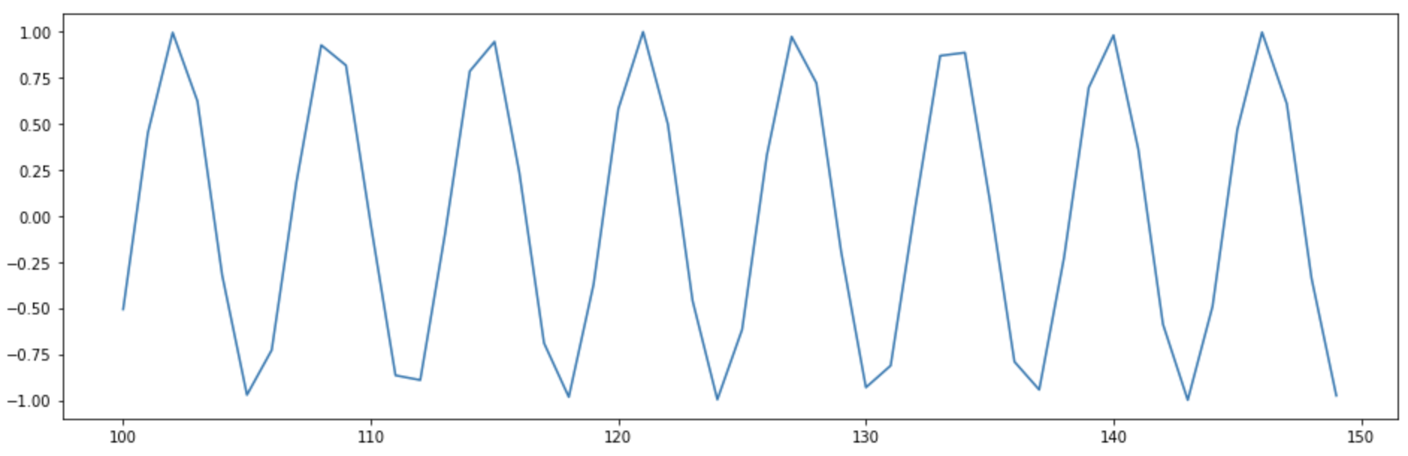
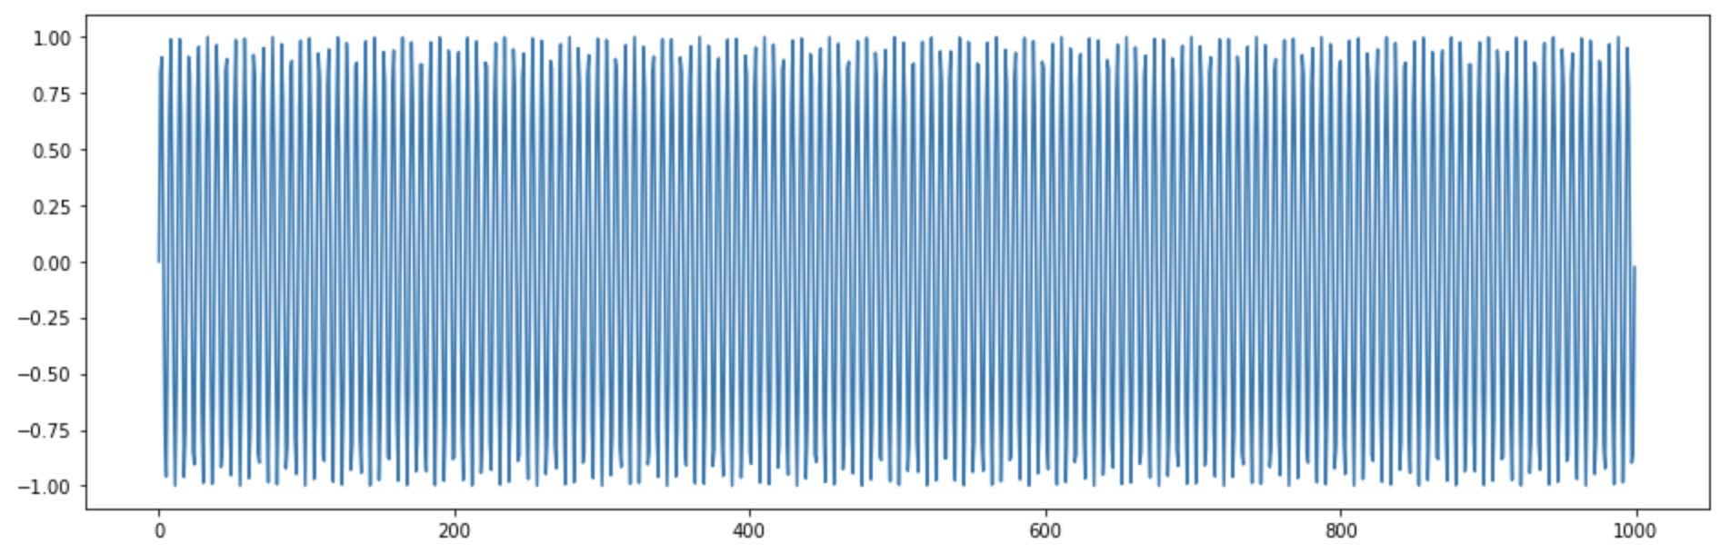
Ergodicity
“A series is said to be ergodic if its statistical properties can be deduced from a single, sufficiently long, random sample of the process” - Wikipedia

Slide 8
What can we use statistical tests for?
To choose the most suitable algorithm in order to satisfy a determined problem
To determine if an algorithm is not recommended to analyse a time series

Slide 9
Statistical tests. Use Cases.
Discriminate non applicable time series algorithms
More suitable selection of algorithms: filtering, distances, forecasting, clustering, etc.
Examples:
ALGORITHM | RECOMMENDATION
ARIMA - FORECASTING | Most suitable for stationary time series.
SIMPLE EXPONENTIAL SMOOTHING - FORECASTING | Most suitable for time series which have no trend and do not contain a seasonal component.
SELF-ORGANIZING MAPS - CLUSTERING | Most suitable for periodic time series
ROBUST ANOMALY DETECTION – ANOMALY DETECTION | Most suitable for stationary time series.

Slide 10
Statistical tests. Use Cases.
ANALISYS | REGULAR | PERIODIC | …
METHOD 1 | YES/NO | YES/NO
METHOD 2
METHOD 3
METHOD 4

Slide 11
Exercise
Dataset: 100 energy consumption time series of commercial sites during 2012. The series are tagged by subindustry.
Target: Apply classical machine learning algorithms in order to predict the subindustry of the time series.
Work to do: Clustering of time series using khiva’s time series features algorithms.

